Slide 1

Exception Handling in Java
Presented by:
Obaydur Rahman,
ID: 213902018
Department of CSE

Slide 2
Outline
Real Life Example
Exception Handling
When Exceptions Happen?
Try, Catch and Finally Keyword
Throw and Throws Keyword
Try-Catch-Finally Syntax
Flow Chart
Checked vs Unchecked Exceptions
Exception Hierarchy
User Defined Exception
Code Example
Conclusion
Exception Handling
02.

Slide 3





Slide 4
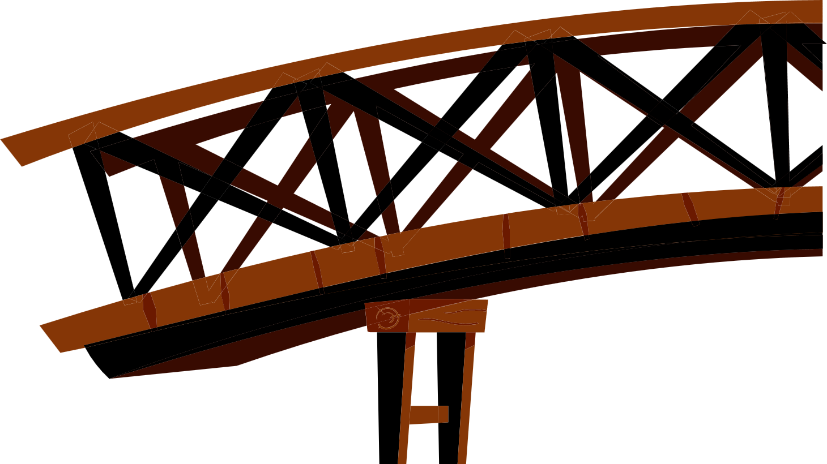
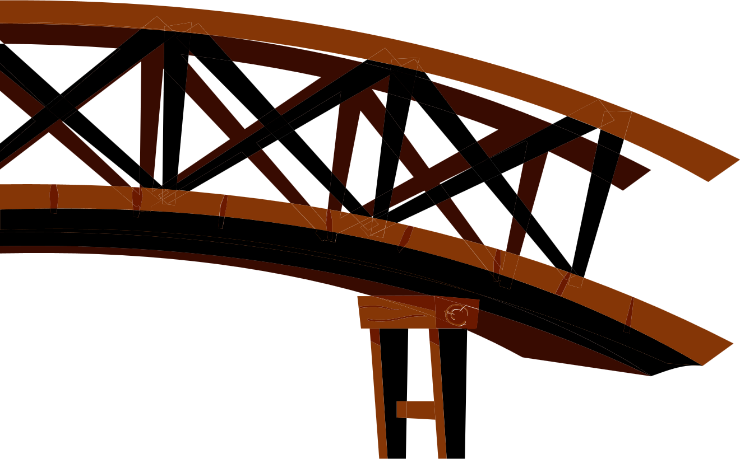

Slide 5
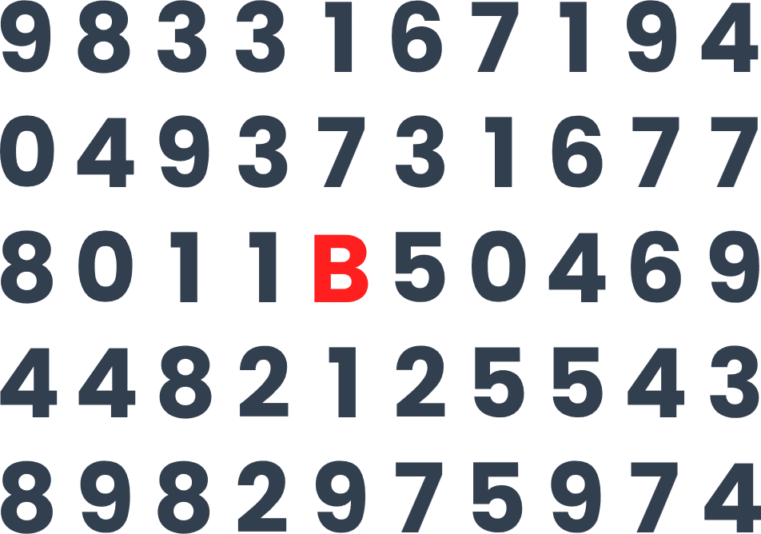
Exception Handling
Exception handling is a mechanism to handle runtime errors in a program
It is a way to handle the errors so that normal flow of the application can be maintained
Exception Handling
05.

Slide 6

When Exceptions Happens?
User enters invalid data
Try to open file that does not exist
Network connection lost
JVM has run out of memory
Hardware failure
Programming error
Exception Handling
06.

Slide 7

Try, Catch and Finally Keyword
Try block is the code that we want to monitor for exceptions
Catch blocks contain codes that catches exceptions and handles them
Finally block is the block that always executes
Exception Handling
07.

Slide 8

Throw and Throws Keyword
Throw keyword is used to throw a new exception.
Throws keyword is used to indicate that the method may throw an exception but does not handle it by itself.
Exception Handling
08.

Slide 9
Try-Catch-Finally Syntax
try {
// try block
} catch (ExceptionObject e) {
// first exception
} catch (AnotherException e) {
// 2nd exception
} catch (MoreException | EvenMore e) {
// one of two exception occurred
} finally {
// finally run this
}
int arr[] = {10};
try {
int num = Integer.parseInt("One");
System.out.println(arr[num]);
} catch (
ArrayIndexOutOfBoundsException |
NumberFormatException e
) {
System.out.println(e);
}
Exception Handling
09.

Slide 10
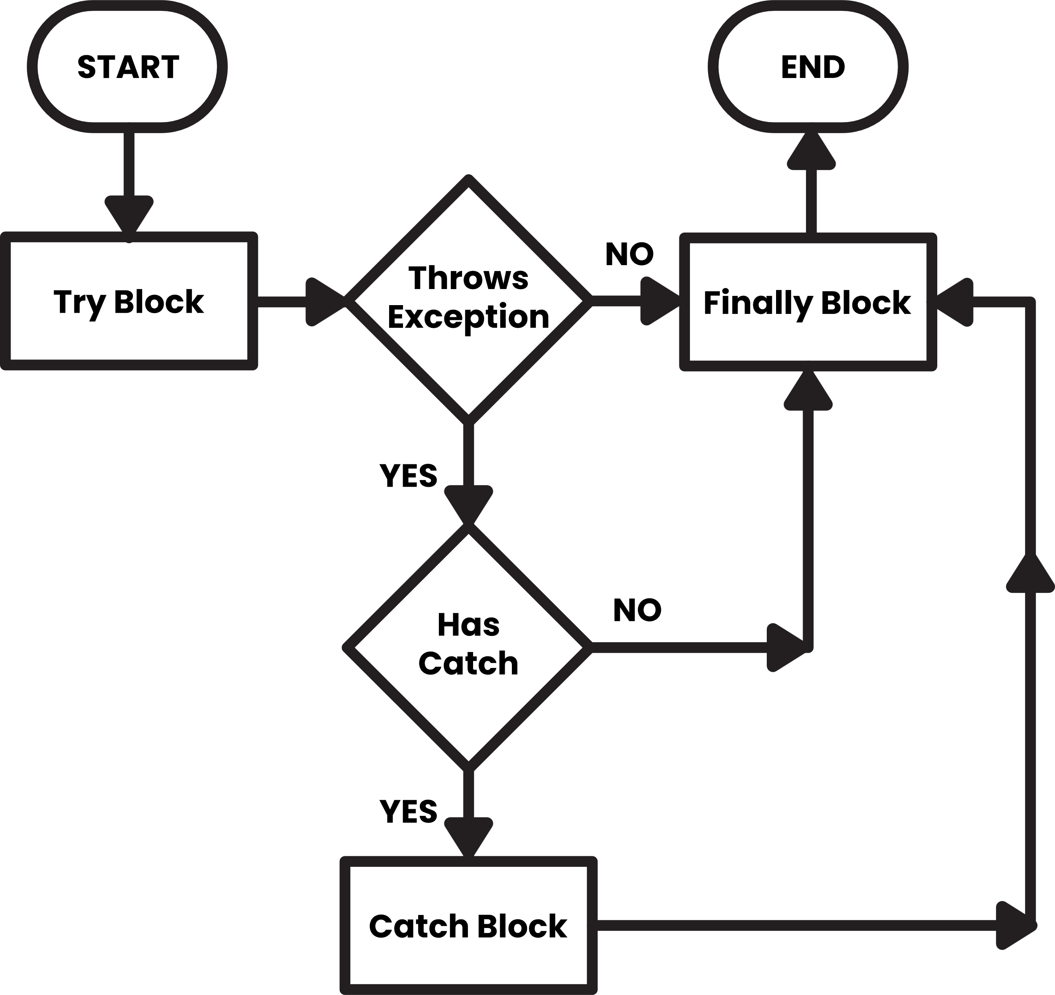
Flow Chart
We can have multiple catch blocks
Try block stops execution on the line where exception occurs
We can nest try-catch in both try and finally block
Exception Handling
10.

Slide 11

Checked vs Unchecked
Checked exceptions are checked at compile time
Unchecked exceptions are not checked at compile time but checked at run time
Exception Handling
11.

Slide 12
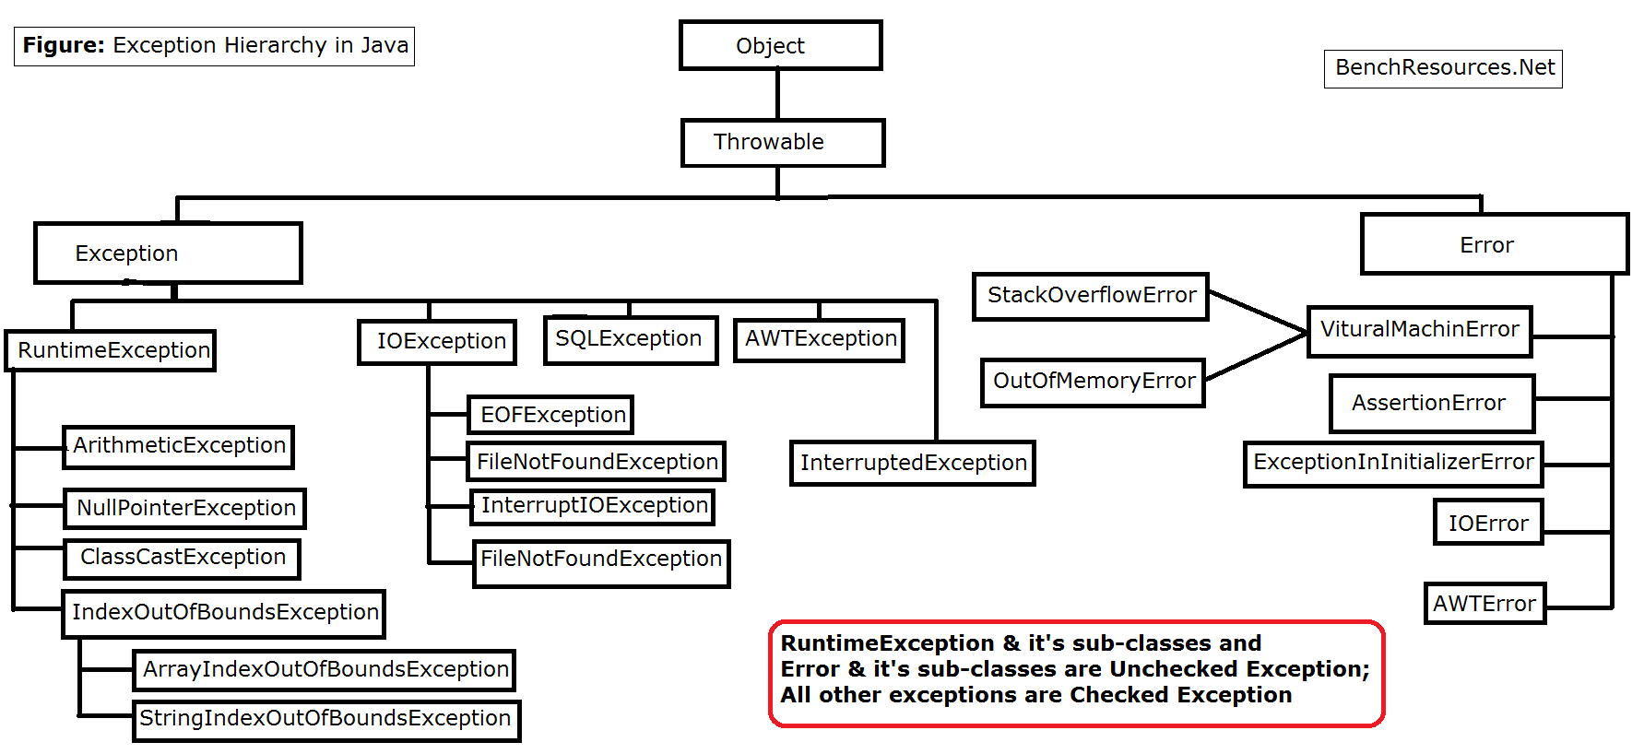
Exception Hierarchy
Exception Handling
12.

Slide 13
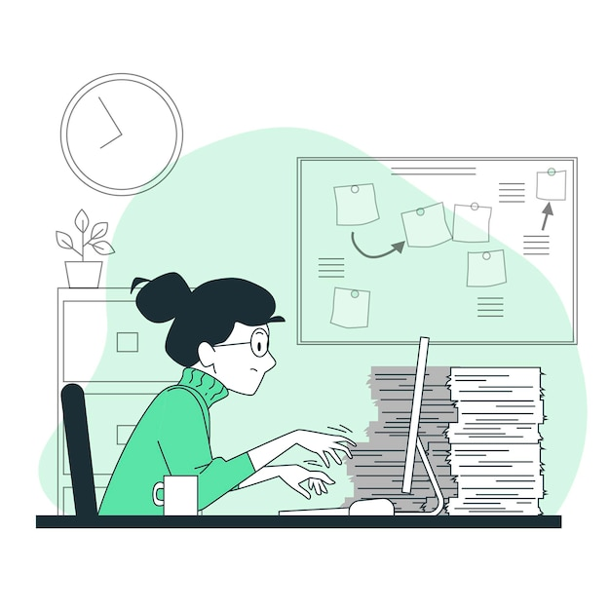
User Defined Exception
A user defined class extending another built-in exception class
Helpful to provide information about application specific errors
Increase readability of code
Easy to debug and maintain large projects
Exception Handling
13.

Slide 14
Example
public class BridgeExample {
public static void main(String[] args) {
try {
crossBridge();
} catch (BridgeCollapsedException e) {
tryToSwim();
}
} public static void crossBridge() throws BridgeCollapsedException {
throw new BridgeCollapsedException(“Opps!");
}
public static void tryToSwim() {
System.out.println("Oh no! Time to swim!");
}
}
class BridgeCollapsedException extends Exception {
public BridgeCollapsedException() {
super();
}
public BridgeCollapsedException(String message) {
super(message);
}
}
Exception Handling
14.

Slide 15
Conclusion
Exception is an event, which occurs during the execution of a program, that disrupts the normal flow of the program's instructions and is an object that represents an error or unexpected event. Using exception handling, you can handle the error and continue the execution of the program.
Exception Handling
15.

Slide 16
Reference
Java The Complete Reference, Seventh Edition
Exception handling – Wikipedia
Images from - FreePik
Exception Handling
16.

Slide 17
Question Time!
Exception Handling
17.

Slide 18
Thanks…
Exception Handling
18.

